Slide 1
Analysis of Algorithms: Introduction
What is Algorithm?
a clearly specified set of simple instructions to be followed to solve a problem
Takes a set of values, as input and
produces a value, or set of values, as output
May be specified
In English
As a computer program
As a pseudo-code
Data structures
Methods of organizing data
Program = algorithms + data structures

Slide 2
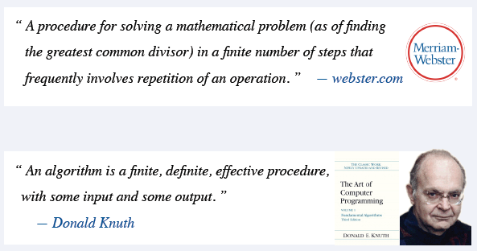
Analysis of Algorithms: Introduction

Slide 3
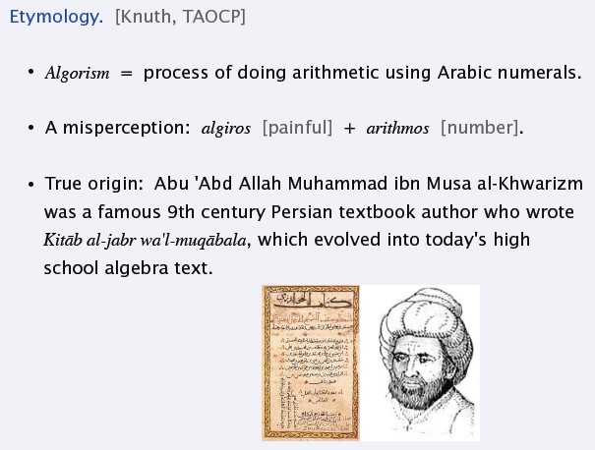
Analysis of Algorithms: Introduction

Slide 4
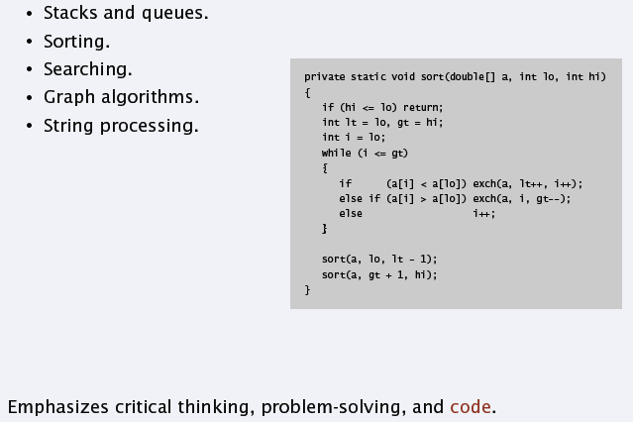
Introduction to Algorithms

Slide 5
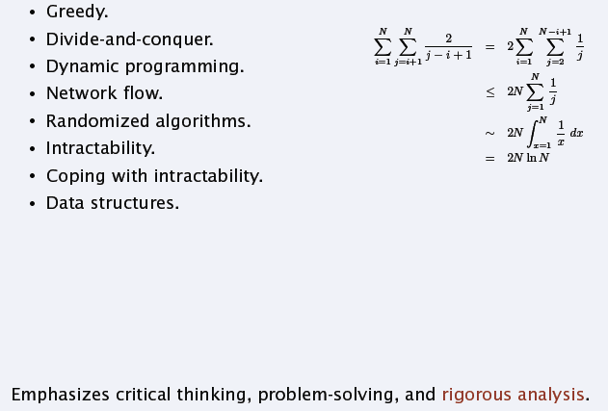
Design and Analysis of Algorithms

Slide 6
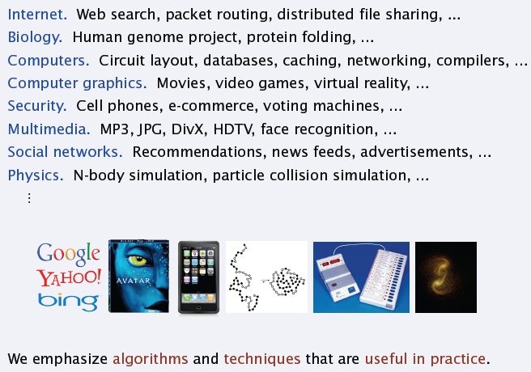
Applications of Algorithms

Slide 7
Introduction
Why need algorithm analysis ?
writing a working program is not good enough
The program may be inefficient!
If the program is run on a large data set, then the running time becomes an issue

Slide 8
Example: Selection Problem
Given a list of N numbers, determine the kth largest, where k ≤ N.
Algorithm 1:
(1) Read N numbers into an array
(2) Sort the array in decreasing order by some simple algorithm
(3) Return the element in position k

Slide 9
Example: Selection Problem…
Algorithm 2:
(1) Read the first k elements into an array and sort them in decreasing order
(2) Each remaining element is read one by one
If smaller than the kth element, then it is ignored
Otherwise, it is placed in its correct spot in the array, bumping one element out of the array.
(3) The element in the kth position is returned as the answer.

Slide 10
Example: Selection Problem…
Which algorithm is better when
N =100 and k = 100?
N =100 and k = 1?
What happens when N = 1,000,000 and k = 500,000?
There exist better algorithms

Slide 11
Algorithm Analysis
We only analyze correct algorithms
An algorithm is correct
If, for every input instance, it halts with the correct output
Incorrect algorithms
Might not halt at all on some input instances
Might halt with other than the desired answer
Analyzing an algorithm
Predicting the resources that the algorithm requires
Resources include
Memory
Communication bandwidth
Computational time (usually most important)

Slide 12
Algorithm Analysis…
Factors affecting the running time
computer
compiler
algorithm used
input to the algorithm
The content of the input affects the running time
typically, the input size (number of items in the input) is the main consideration
E.g. sorting problem ⇒ the number of items to be sorted
E.g. multiply two matrices together ⇒ the total number of elements in the two matrices
Machine model assumed
Instructions are executed one after another, with no concurrent operations ⇒ Not parallel computers

Slide 13
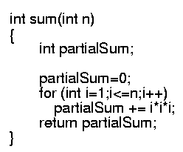
Example
Calculate
Lines 1 and 4 count for one unit each
Line 3: executed N times, each time four units
Line 2: (1 for initialization, N+1 for all the tests, N for all the increments) total 2N + 2
total cost: 6N + 4 ⇒ O(N)
1
2
3
4
1
2N+2
4N
1

Slide 14
Worst- / average- / best-case
Worst-case running time of an algorithm
The longest running time for any input of size n
An upper bound on the running time for any input
⇒ guarantee that the algorithm will never take longer
Example: Sort a set of numbers in increasing order; and the data is in decreasing order
The worst case can occur fairly often
E.g. in searching a database for a particular piece of information
Best-case running time
sort a set of numbers in increasing order; and the data is already in increasing order
Average-case running time
May be difficult to define what “average” means

Slide 15
Running-time of algorithms
Bounds are for the algorithms, rather than programs
programs are just implementations of an algorithm, and almost always the details of the program do not affect the bounds
Bounds are for algorithms, rather than problems
A problem can be solved with several algorithms, some are more efficient than others

Slide 16
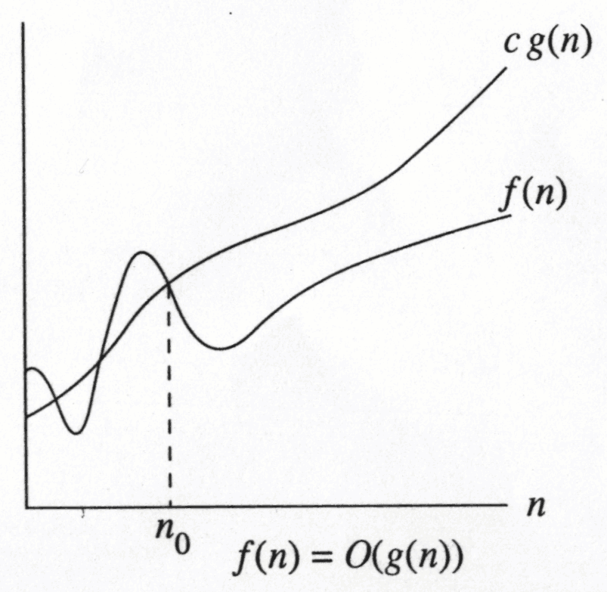
Growth Rate
The idea is to establish a relative order among functions for large n
∃ c , n₀ > 0 such that f(N) ≤ c g(N) when N ≥ n₀
f(N) grows no faster than g(N) for “large” N

Slide 17
Asymptotic notation: Big-Oh
f(N) = O(g(N))
There are positive constants c and n₀ such that
f(N) ≤ c g(N) when N ≥ n₀
The growth rate of f(N) is less than or equal to the growth rate of g(N)
g(N) is an upper bound on f(N)

Slide 18
Big-Oh: example
Let f(N) = 2N². Then
f(N) = O(N⁴)
f(N) = O(N³)
f(N) = O(N²) (best answer, asymptotically tight)
O(N²): reads “order N-squared” or “Big-Oh N-squared”

Slide 19
Big Oh: more examples
N² / 2 – 3N = O(N²)
1 + 4N = O(N)
7N² + 10N + 3 = O(N²) = O(N³)
log₁₀ N = log₂ N / log₂ 10 = O(log₂ N) = O(log N)
sin N = O(1); 10 = O(1), 10¹⁰ = O(1)
log N + N = O(N)
log^{k} N = O(N) for any constant k
N = O(2^{N}), but 2^{N} is not O(N)
2^{10N} is not O(2^{N})

Slide 20
Math Review: logarithmic functions

Slide 21
Some rules
When considering the growth rate of a function using Big-Oh
Ignore the lower order terms and the coefficients of the highest-order term
No need to specify the base of logarithm
Changing the base from one constant to another changes the value of the logarithm by only a constant factor
If T₁(N) = O(f(N) and T₂(N) = O(g(N)), then
T₁(N) + T₂(N) = max(O(f(N)), O(g(N))),
T₁(N) * T₂(N) = O(f(N) * g(N))

Slide 22
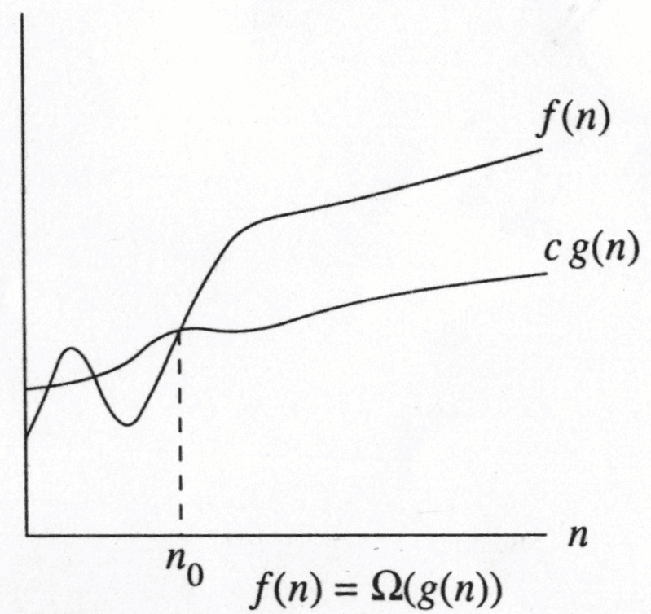
Big-Omega
∃ c , n₀ > 0 such that f(N) ≥ c g(N) when N ≥ n₀
f(N) grows no slower than g(N) for “large” N

Slide 23
Big-Omega
f(N) = Ω(g(N))
There are positive constants c and n₀ such that
f(N) ≥ c g(N) when N ≥ n₀
The growth rate of f(N) is greater than or equal to the growth rate of g(N).

Slide 24
Big-Omega: examples
Let f(N) = 2N². Then
f(N) = Ω(N)
f(N) = Ω(N²) (best answer)

Slide 25
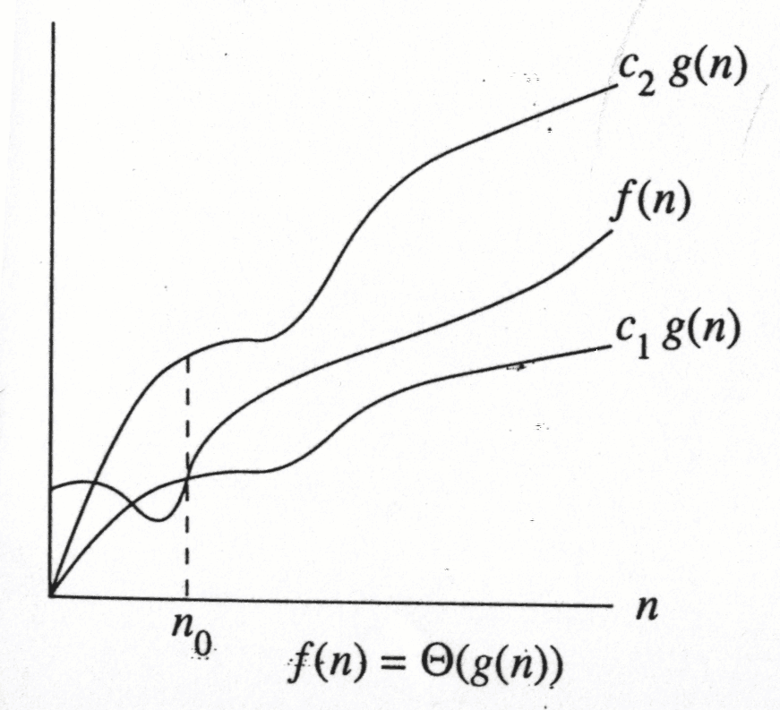
f(N) = Θ(g(N))
the growth rate of f(N) is the same as the growth rate of g(N)

Slide 26
Big-Theta
f(N) = Θ(g(N)) iff
f(N) = O(g(N)) and f(N) = Ω(g(N))
The growth rate of f(N) equals the growth rate of g(N)
Example: Let f(N)=N² , g(N)=2N²
Since f(N) = O(g(N)) and f(N) = Ω(g(N)),
thus f(N) = Θ(g(N)).
Big-Theta means the bound is the tightest possible.

Slide 27
Some rules
If T(N) is a polynomial of degree k, then
T(N) = Θ(N^{k}).
For logarithmic functions,
T(log_{m} N) = Θ(log N).

Slide 28
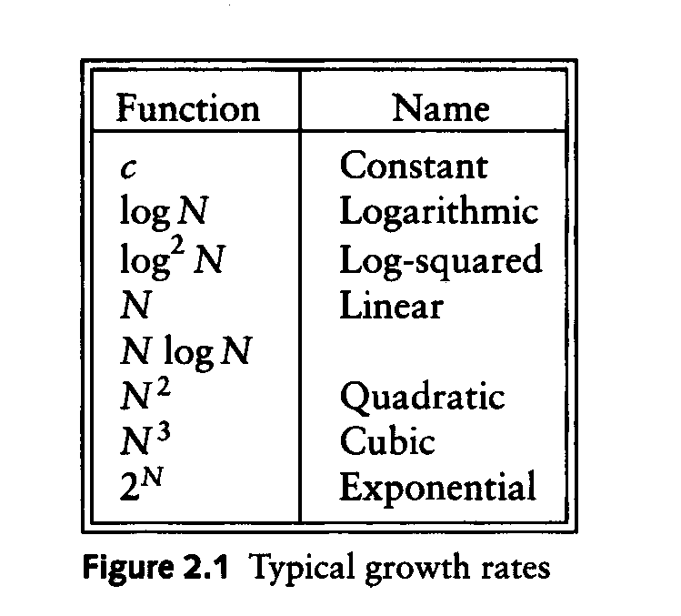
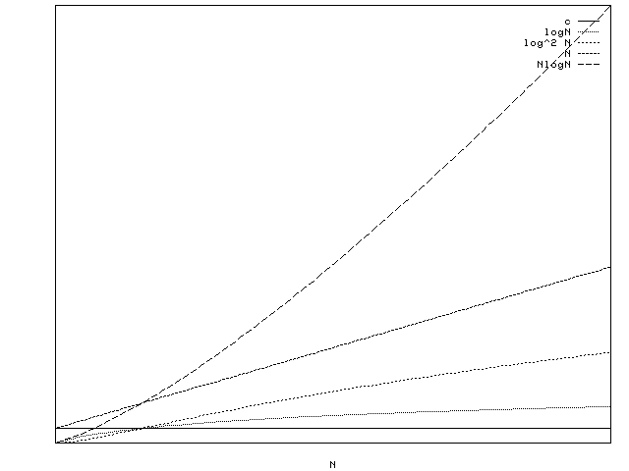
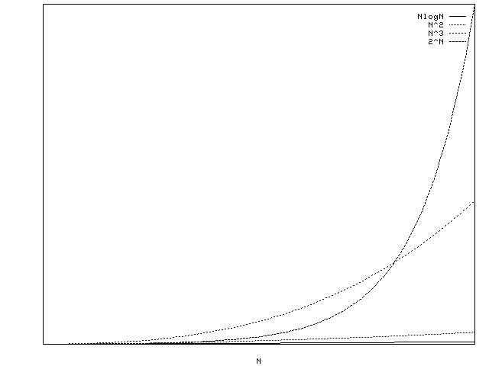
Typical Growth Rates

Slide 29
Growth rates …
Doubling the input size
f(N) = c ⇒ f(2N) = f(N) = c
f(N) = log N ⇒ f(2N) = f(N) + log 2
f(N) = N ⇒ f(2N) = 2 f(N)
f(N) = N² ⇒ f(2N) = 4 f(N)
f(N) = N³ ⇒ f(2N) = 8 f(N)
f(N) = 2^{N} ⇒ f(2N) = f²(N)
Advantages of algorithm analysis
To eliminate bad algorithms early
pinpoints the bottlenecks, which are worth coding carefully

Slide 30
Using L' Hopital's rule
L' Hopital's rule
If and
then =
Determine the relative growth rates (using L' Hopital's rule if necessary)
compute
if 0: f(N) = O(g(N)) and f(N) is not Θ(g(N))
if constant ≠ 0: f(N) = Θ(g(N))
if ∞: f(N) = Ω(f(N)) and f(N) is not Θ(g(N))
limit oscillates: no relation

Slide 31

General Rules
For loops
at most the running time of the statements inside the for-loop (including tests) times the number of iterations.
Nested for loops
the running time of the statement multiplied by the product of the sizes of all the for-loops.
O(N²)

Slide 32
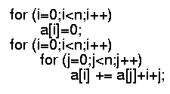
General rules (cont’d)
Consecutive statements
These just add
O(N) + O(N²) = O(N²)
If S1
Else S2
never more than the running time of the test plus the larger of the running times of S1 and S2.

Slide 33
Another Example
Maximum Subsequence Sum Problem
Given (possibly negative) integers A₁, A₂, ...., A_{n}, find the maximum value of
For convenience, the maximum subsequence sum is 0 if all the integers are negative
E.g. for input –2, 11, -4, 13, -5, -2
Answer: 20 (A₂ through A₄)

Slide 34
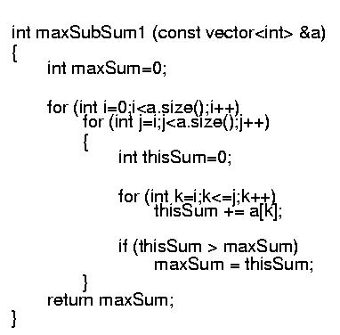
Algorithm 1: Simple
Exhaustively tries all possibilities (brute force)
O(N³)

Slide 35
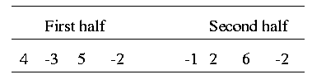
Algorithm 2: Divide-and-conquer
Divide-and-conquer
split the problem into two roughly equal subproblems, which are then solved recursively
patch together the two solutions of the subproblems to arrive at a solution for the whole problem
The maximum subsequence sum can be
Entirely in the left half of the input
Entirely in the right half of the input
It crosses the middle and is in both halves

Slide 36
Algorithm 2 (cont’d)
The first two cases can be solved recursively
For the last case:
find the largest sum in the first half that includes the last element in the first half
the largest sum in the second half that includes the first element in the second half
add these two sums together

Slide 37
Algorithm 2 …
O(1)
T(m/2)
T(m/2)
O(m)
O(1)

Slide 38
Algorithm 2 (cont’d)
Recurrence equation
2 T(N/2): two subproblems, each of size N/2
N: for “patching” two solutions to find solution to whole problem

Slide 39
Algorithm 2 (cont’d)
Solving the recurrence:
With k=log N (i.e. 2^{k} = N), we have
Thus, the running time is O(N log N)
faster than Algorithm 1 for large data sets

